Slide 1

COVID-19 Outbreak Data Analysis and Risk Prediction
K S SCHOOL OF ENGINEERING & MANAGEMENT, BENGALURU-560109
DEPARTMENT OF COMPUTER SCIENCE & ENGINEERING
PROJECT PHASE II
(17CSP78 )
Academic Year 2020-21 (Even)
Presented By
Project Guide
Mr. Sandeep H
Associate Professor,
CSE, KSSEM
1KG17CS079
1KG17CS105
1KG17CS106
1KG17CS110
Shashank V
Varun Kumar T H
Vikas B
Yashash T V

Slide 2
Outline
Introduction
Aim of the Project
Literature Survey
Objectives
Methodology
Technologies Used
Requirements
Design
Implementation
Result Analysis and Discussion
Conclusion
References

Slide 3
Introduction
The COVID-19 pandemic, also known as the coronavirus pandemic, is an ongoing pandemic of coronavirus disease 2019 caused by severe acute respiratory syndrome coronavirus 2(SARS-CoV-2).
It was first identified in December 2019 in Wuhan, China. Soon, the virus was in all continents and over 180 countries.
The World Health Organization declared the outbreak as Public Health Emergency of International Concern in January 2020, and a pandemic in March 2020 by WHO.
As of 22 May 2021, 161 Million cases have been confirmed with more than 5 million deaths attributed to COVID-19.
This project attempts to provide an analysis and predict the risk faced by an individual for Coronavirus Disease (COVID-19).

Slide 4
AIM OF THE PROJECT
To Analyse and Predict the risk of COVID-19 using Machine Learning.

Slide 5
Literature Survey
[1] CoronaTracker: World-wide COVID-19 Outbreak Data Analysis and Prediction
Proposes to interpret patters of public sentiment of dissemination related to health information, and assess political and economic influence of the spread of the virus using sentiment analysis.
The dataset here is extracted from John Hopkins University, WHO and DingXiangYuan, a website authorized by the Chinese government
[2] Developing a COVID-19 mortality risk prediction model when individual-level data are not available
Proposes a hybrid methodology, which allows the construction of a multivariable prediction model without access to individual-level data pertaining to the current pandemic.
Demonstrates how this methodology was used in practice to develop a model during the first weeks of the COVID-19 pandemic.

Slide 6
OBJECTIVES
To perform necessary pre-processing steps.
To develop a predictive machine learning model for COVID-19.
To do performance evaluation for the machine learning model.
To predict the risks of COVID-19 using the model, presented through a web interphase.

Slide 7
METHODOLOGY
Methodology for objective 1: the necessary data cleaning such as encoding was performed on the dataset. This helps in developing a more precise and accurate model.
Methodology for Objective 2: The predictive model to predict the risk and present the analysis of COVID-19 can be implemented through machine learning algorithms such as Logistic Regression, Random Forest Classifier, SVC, DecisionTreeClassifier, KNeighborsClassifier and GradientBoostingClassifier .
Methodology for Objective 3: The performance of the machine learning model is measured by comparing the results with existing machine learning techniques to generate more accurate and precise result. Methods such as accuracy scores and confusion matrices are used.
Methodology for Objective 4: The analysis and risks of COVID-19 is predicted through predictive model and presented through a web interphase using flask and html.

Slide 8
Technologies used
Sublime Text:
Sublime Text is a shareware cross-platform source code editor with a Python application programming interface. It natively supports many programming languages and markup languages, and functions can be added by users with plugins.
Spyder:
Spyder is an open-source cross-platform integrated development environment for scientific programming in the Python language.

Slide 9
Requirements
GPU: 2.30 Ghz
CPU: Intel i5 / Intel Core or better
RAM: 3 GB or more
Operating system: Windows 7 , Windows 8.1 or later, Windows 10
Browser: Mozilla or Chrome (Latest version)

Slide 10
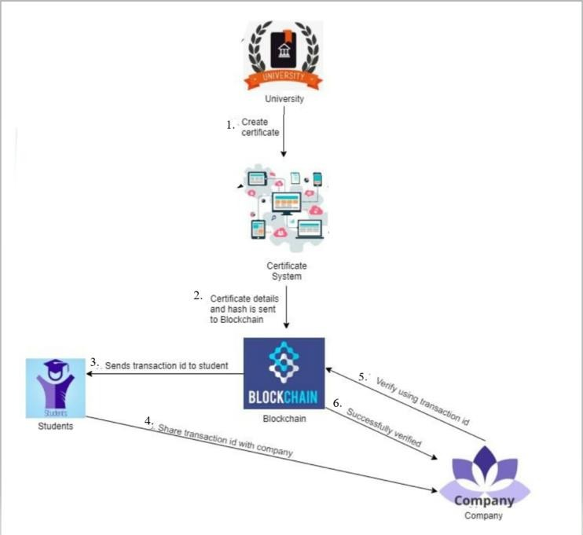
Brief Overview of Project
Fig 1. An overall model of How the certificate is stored in the blockchain network

Slide 11

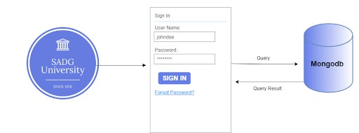
Design
Admin login
Fig 3. Interaction between Issuer and the Front end system.

Slide 12

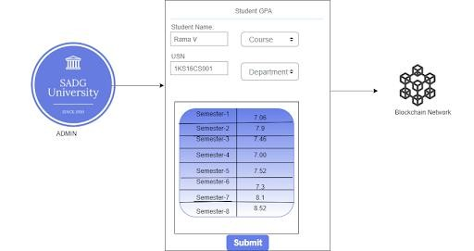
Filling Academic Certificate
Fig 4. Interaction between Issuer and the Blockchain Network.

Slide 13

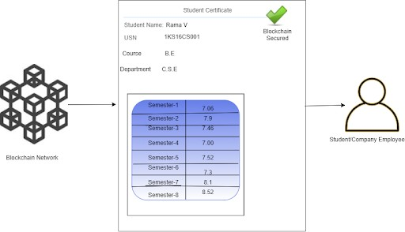
View and verification by Users
Fig 4. Interaction between User and the Blockchain Network.

Slide 14
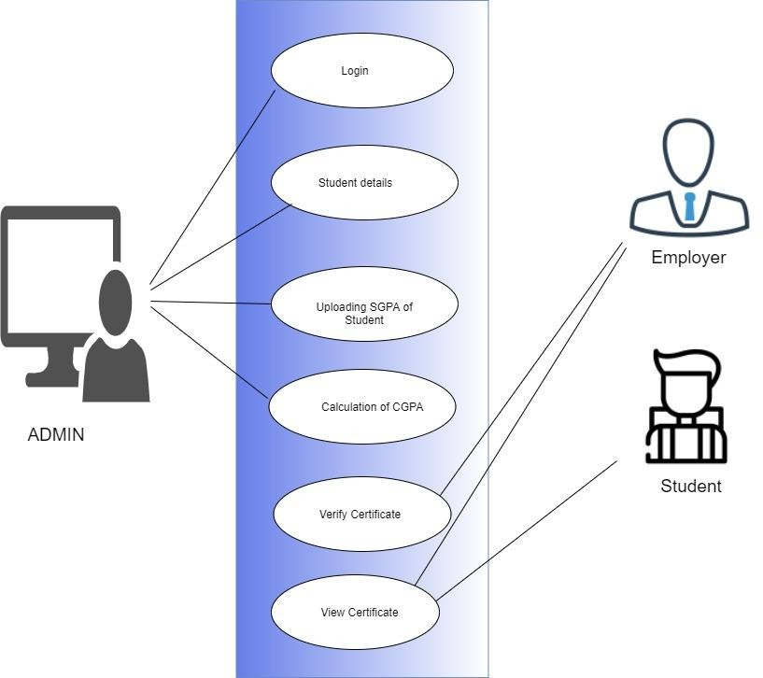
Use Case Diagram
Fig 2. Use Case Diagram For Blockchain based Academic Certificate Authentication System

Slide 15
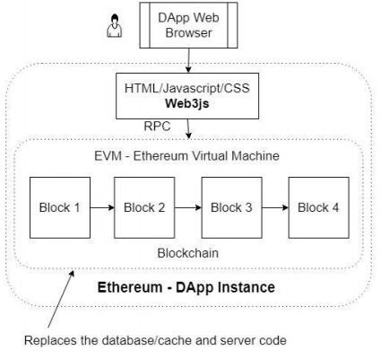
Ethereum Dapp Architecture
Fig 5. Ethereum Dapp Architecture

Slide 16

Implementation
Fig 6. Admin Login Page

Slide 17
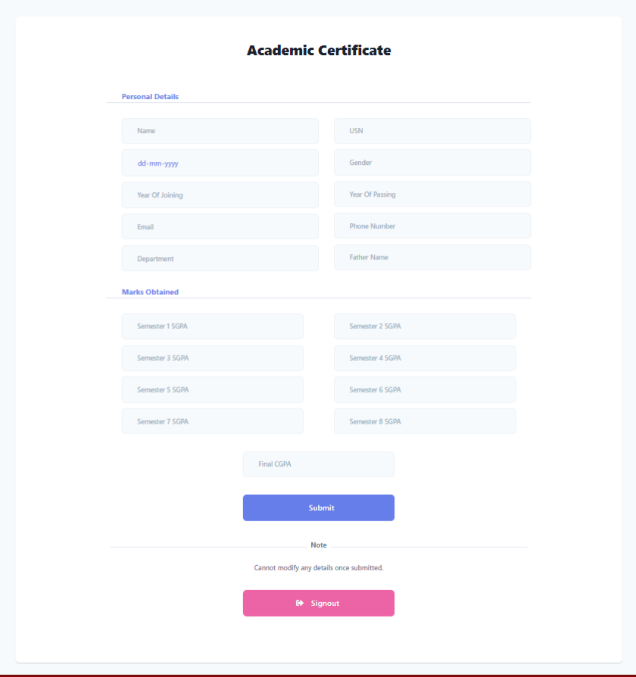

Implementation
Fig 7. Form to Fill Academic Details

Slide 18
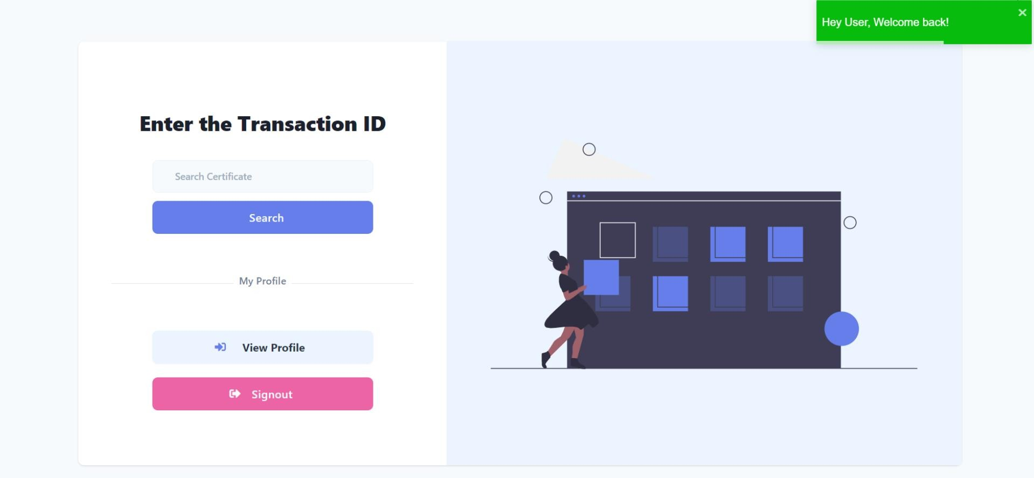
Implementation
Fig 7. Page to view Certificate

Slide 19
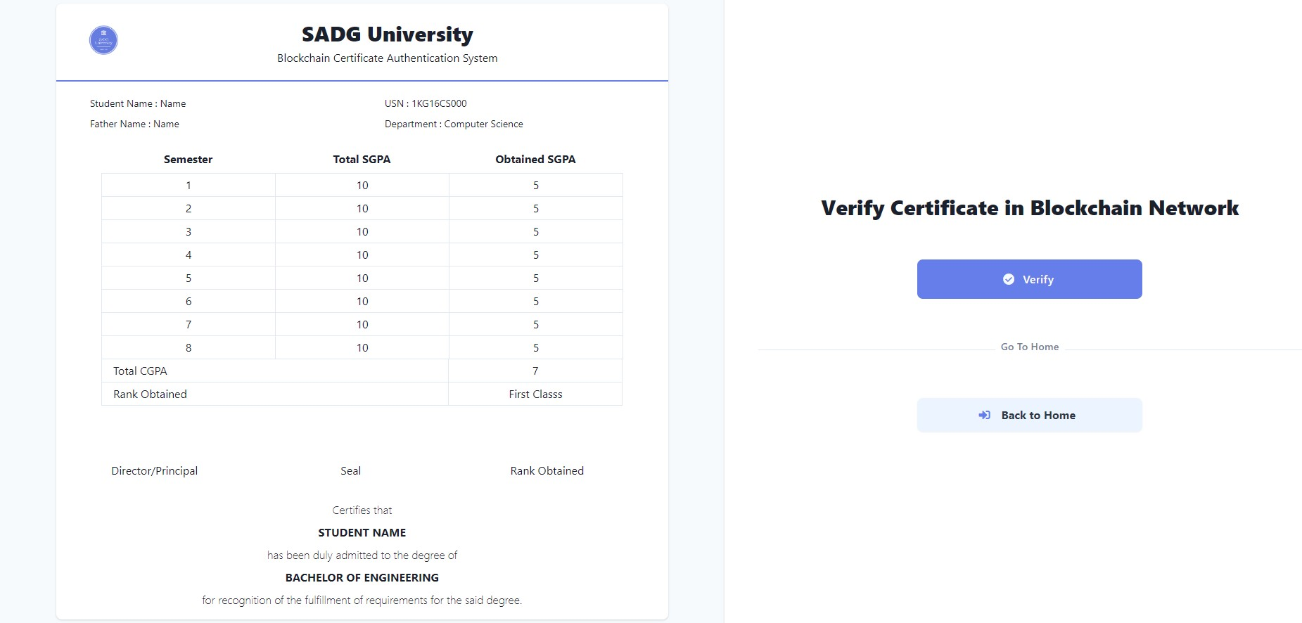
Implementation
Fig 8. Certficate View and Verify Page

Slide 20
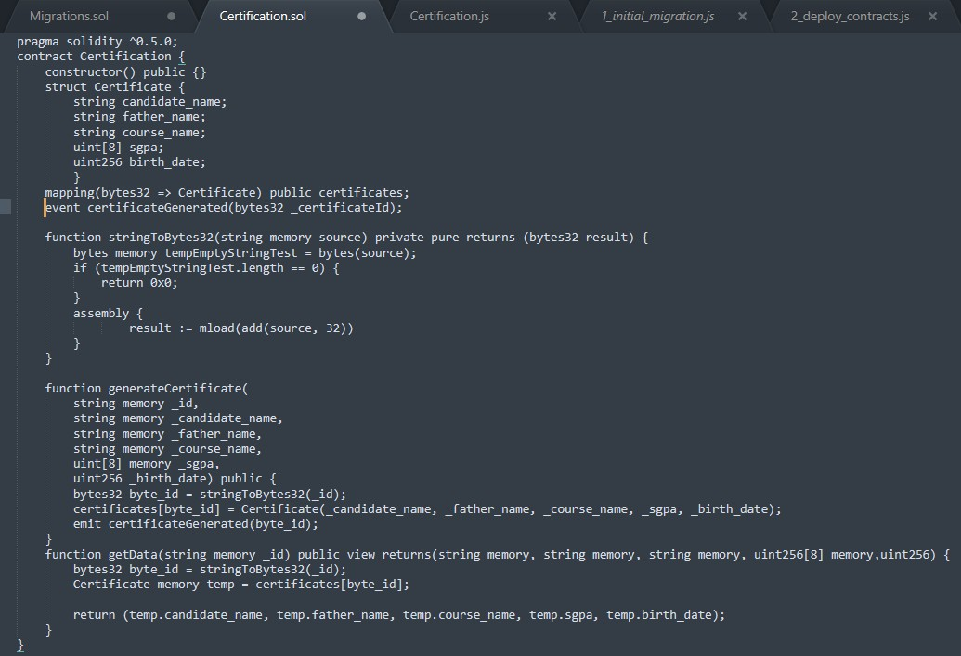
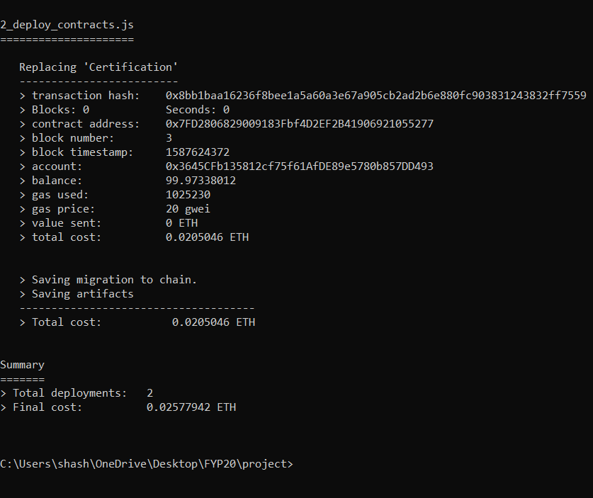
Implementation
Fig 9. Source code of Contract
Fig 10. Contract Deployment to Ethereum Blockchain

Slide 21
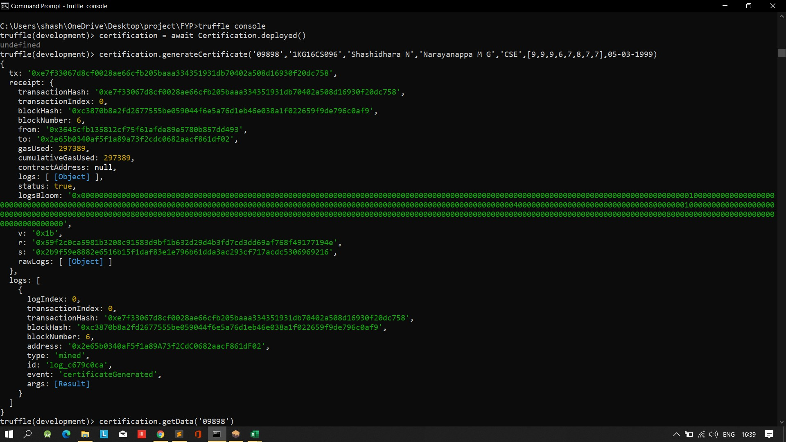
Implementation
Fig 11. Generating a Certificate

Slide 22
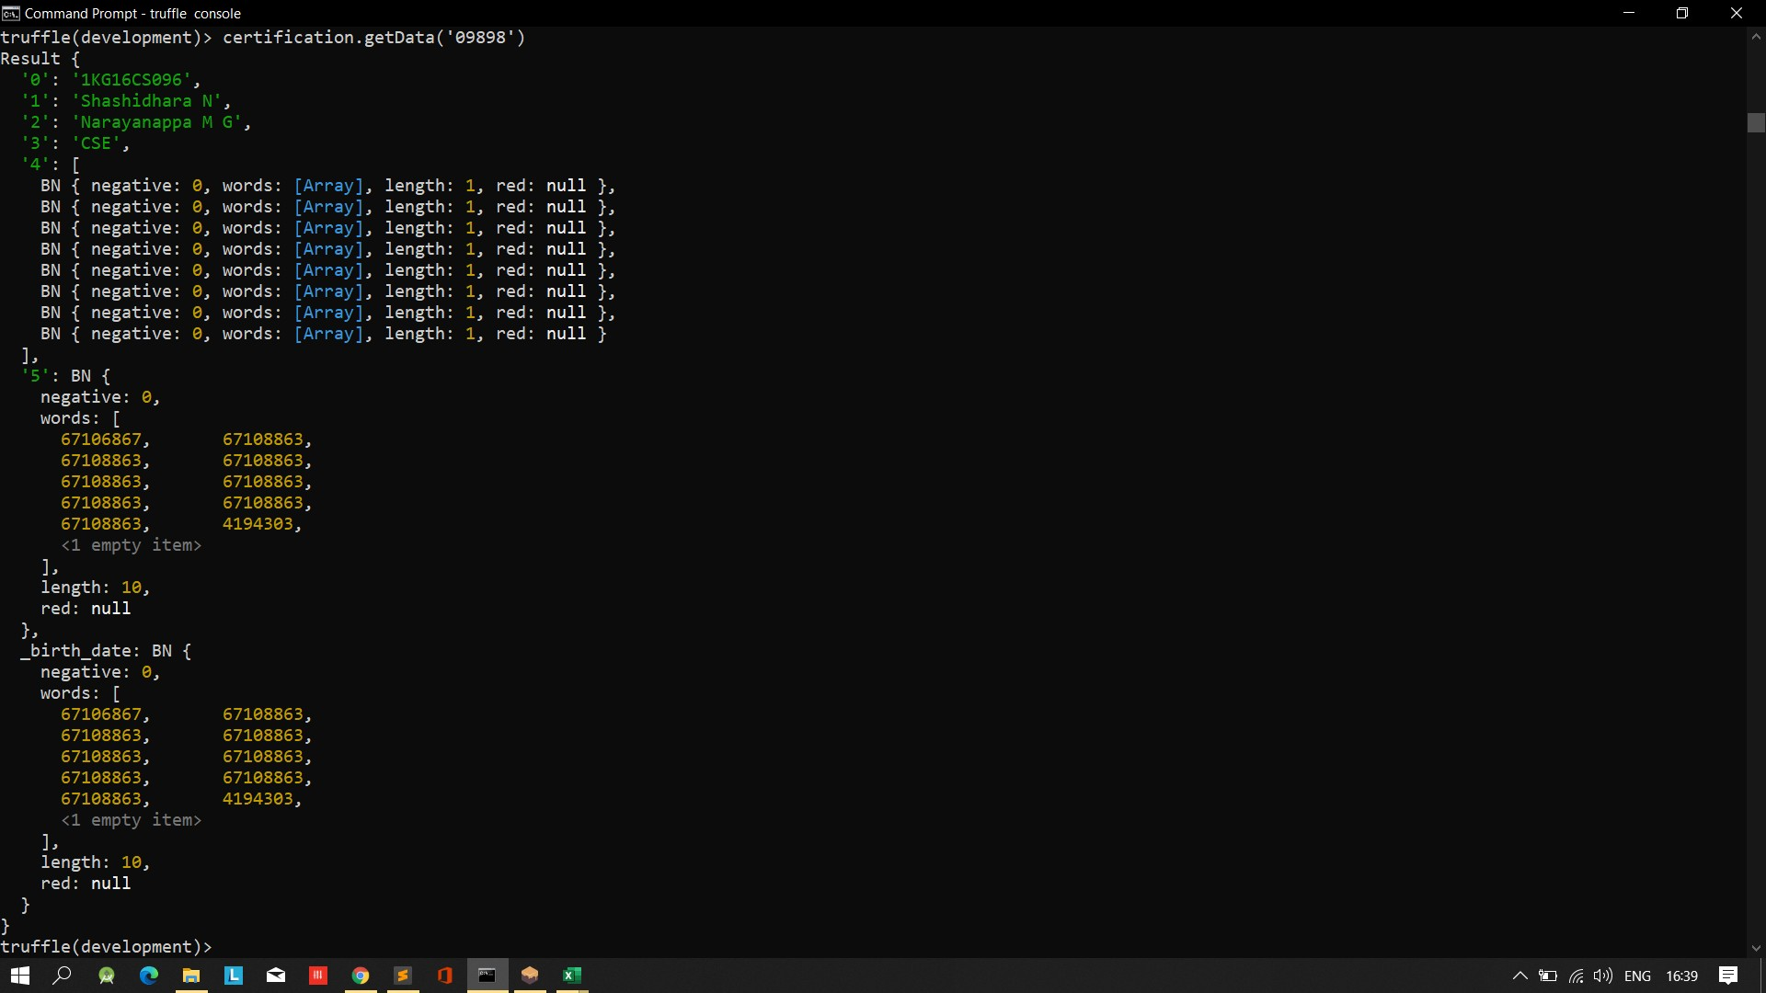
Implementation
Fig 12. Displaying a Certificate

Slide 23
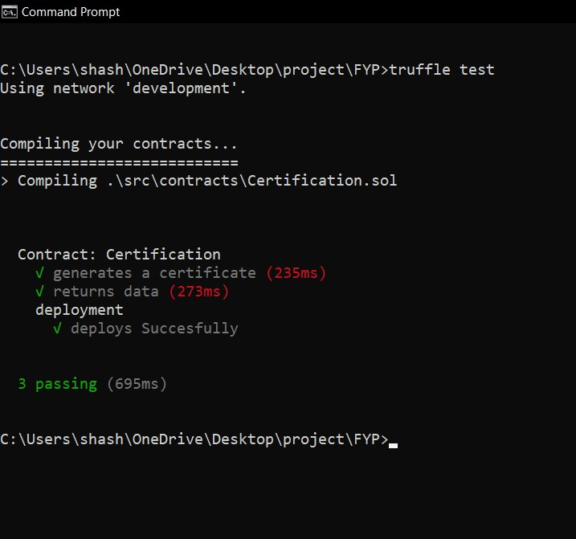
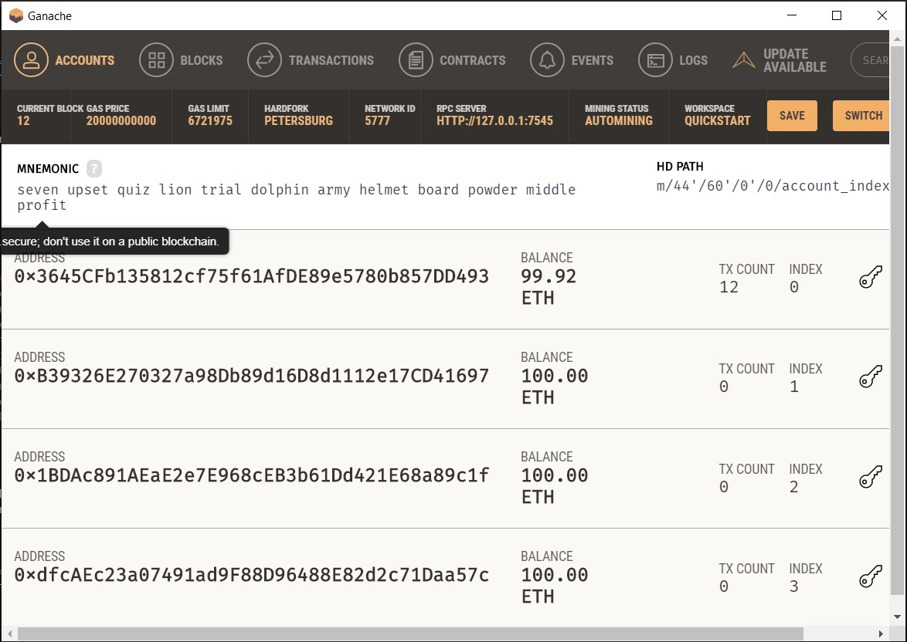
Implementation
Fig 13. Test Suite For Deployment
Fig 14. Ether being Used for Deployment

Slide 24
CONCLUSION
Objectives are being met within the expected time intervals.
All issues or cases are being extensively researched and discussed with guide, effective measures are
being taken.
Documentation is being done in parallel.
So far the work appears to be supporting the respective objectives.

Slide 25
REFERENCES
[1]. Binti Hamzah FA, Lau C, Nazri H, Ligot DV, Lee G, Tan CL, et al. CoronaTracker: WorldwideCOVID-19 Outbreak Data Analysis and Prediction. [Preprint]. Bull World Health Organ.E-pub: 19 March 2020. doi: http://dx.doi.org/10.2471/BLT.20.255695.
[2]. Harmon, S.A., Sanford, T.H., Xu, S. et al. Artificial intelligence for the detection of COVID-19 pneumonia on chest CT using multinational datasets. Nat Commun 11, 4080 (2020). https://doi.org/10.1038/s41467-020-17971-2

Slide 26



THANK YOU

Slide 27





